Slide 1
Exploring Mary’s Journey: Managing Mild Cognitive Impairment (MCI)

Slide 2





Meet Group 19
Sunjeev
Somu
Suha
Shafi
Samkitt Patni
Gaurav Kewalramani
Mohammad Wathiq Soualhi

Slide 3
Understanding Mild Cognitive Impairment (MCI)
MCI is a condition in which people have more memory or thinking problems than other people their age (National Institute on Aging, 2024).
Common symptoms:
Memory lapses
Difficulty finding words
Disorientation.
Risk factors:
Age (65+)
Family history
Prior stroke
Hypertension.
Potential progression: Up to 15% of MCI cases may advance to Alzheimer’s annually (Alzheimer’s Association, 2024).
Notes:
[Mohammad Wathiq Soualhi]: Let’s start with what MCI is. It’s a condition where cognitive decline is noticeable but doesn’t yet disrupt daily activities—think memory lapses, trouble finding words, or disorientation. Key risk factors include being over 65, having a family history of Alzheimer’s, or conditions like a prior stroke or hypertension, which Mary has. The concerning part is that up to 15% of MCI cases can progress to Alzheimer’s each year, according to the Alzheimer’s Association. This slide gives a quick snapshot to set the stage for Mary’s journey, which we’ll explore next.

Slide 4
Meet Mary: Our Fictional Patient and Methodology
Introduction to Mary
65 years old, retired elementary school teacher, 162 cm, 75 kg.
Ancestral history: Alzheimer’s (maternal grandmother, aunt).
Medical history: Stroke (age 61), hypertension; Meds: Lisinopril, Aspirin, Atorvastatin.
Lifestyle: Mild activity (walks, community events), high-sugar/sodium diet.
Symptoms: Memory lapses, speech difficulties, disorientation, anxiety.
Methodology
Followed Mary’s journey to understand her MCI care under NHS/NICE guidelines.
Mapped interactions with actors (e.g., GP, Memory Clinic, EHRs, NHS Spine).
Used a swimlane diagram to visualize her journey and data flows.
Notes:
[Mohammad Wathiq Soualhi]: I will now be introducing Mary, our fictional patient. She’s a 65-year-old retired elementary school teacher, 162 cm tall, weighing 75 kg. Mary has a strong family history of Alzheimer’s—her maternal grandmother and aunt were both diagnosed. She’s had a stroke at 61 and has hypertension, managed with Lisinopril, Aspirin, and Atorvastatin. Her lifestyle includes mild activity like daily walks and community events, but her diet is high in sugar and sodium. Mary’s been experiencing memory lapses, speech difficulties, momentary disorientation, and anxiety, which prompted her to seek help. To understand her care for MCI, we followed her journey through the NHS system, using NHS/NICE guidelines. We mapped her interactions with actors like her GP, Memory Clinic, and systems like the NHS Spine and EHRs. We then created a swimlane diagram to visualize her journey and the data flows between these actors, which we’ll show you next.

Slide 5
Identification of Main Actors and Interactions
Human Actors | Electronic Actors
Patient: Mary: Reports symptoms, engages with care. | EHR Systems : Primary Care EHR, Hospital EHR – Store and share patient data (e.g., symptoms, test results).
Family/Caregivers: Support Mary, communicate with care team. | NHS Spine: Syncs data (e.g., Summary Care Record) across systems.
Healthcare Providers: GP, Memory Clinic Team, Occupational Therapist, Dietitian, Speech Therapist – Assess, diagnose, and support Mary. | Specialized Systems: LIS, RIS/PACS, Genetic Testing Systems – Process tests and imaging.
Specialists: Laboratory Technicians, Radiologist – Conduct tests (e.g., blood tests, MRI). | Coordination Systems: Digital Referral System, Integrated Care Platform – Transmit referrals, share care plans.
 | Patient Portal: Displays records, appointments for Mary.
Notes:
[Gaurav Kewalramani]: This slide highlights the key actors in Mary’s care journey. On the left, we have human actors: Mary herself, who reports symptoms and engages with care; her family and caregivers, who provide support; healthcare providers like her GP, Memory Clinic Team, and allied health professionals, who assess, diagnose, and support her; and specialists like lab technicians and radiologists, who conduct tests such as blood work and MRIs. On the right, we have electronic actors: EHR systems that store and share data like symptoms and test results; the NHS Spine, which syncs data across the system; specialized systems like the LIS and PACS for processing tests and imaging; coordination systems that handle referrals and care plans; and the Patient Portal, which lets Mary access her records. These actors interact to deliver Mary’s care, and we’ll see how in the next slide with our swimlane diagram.

Slide 6
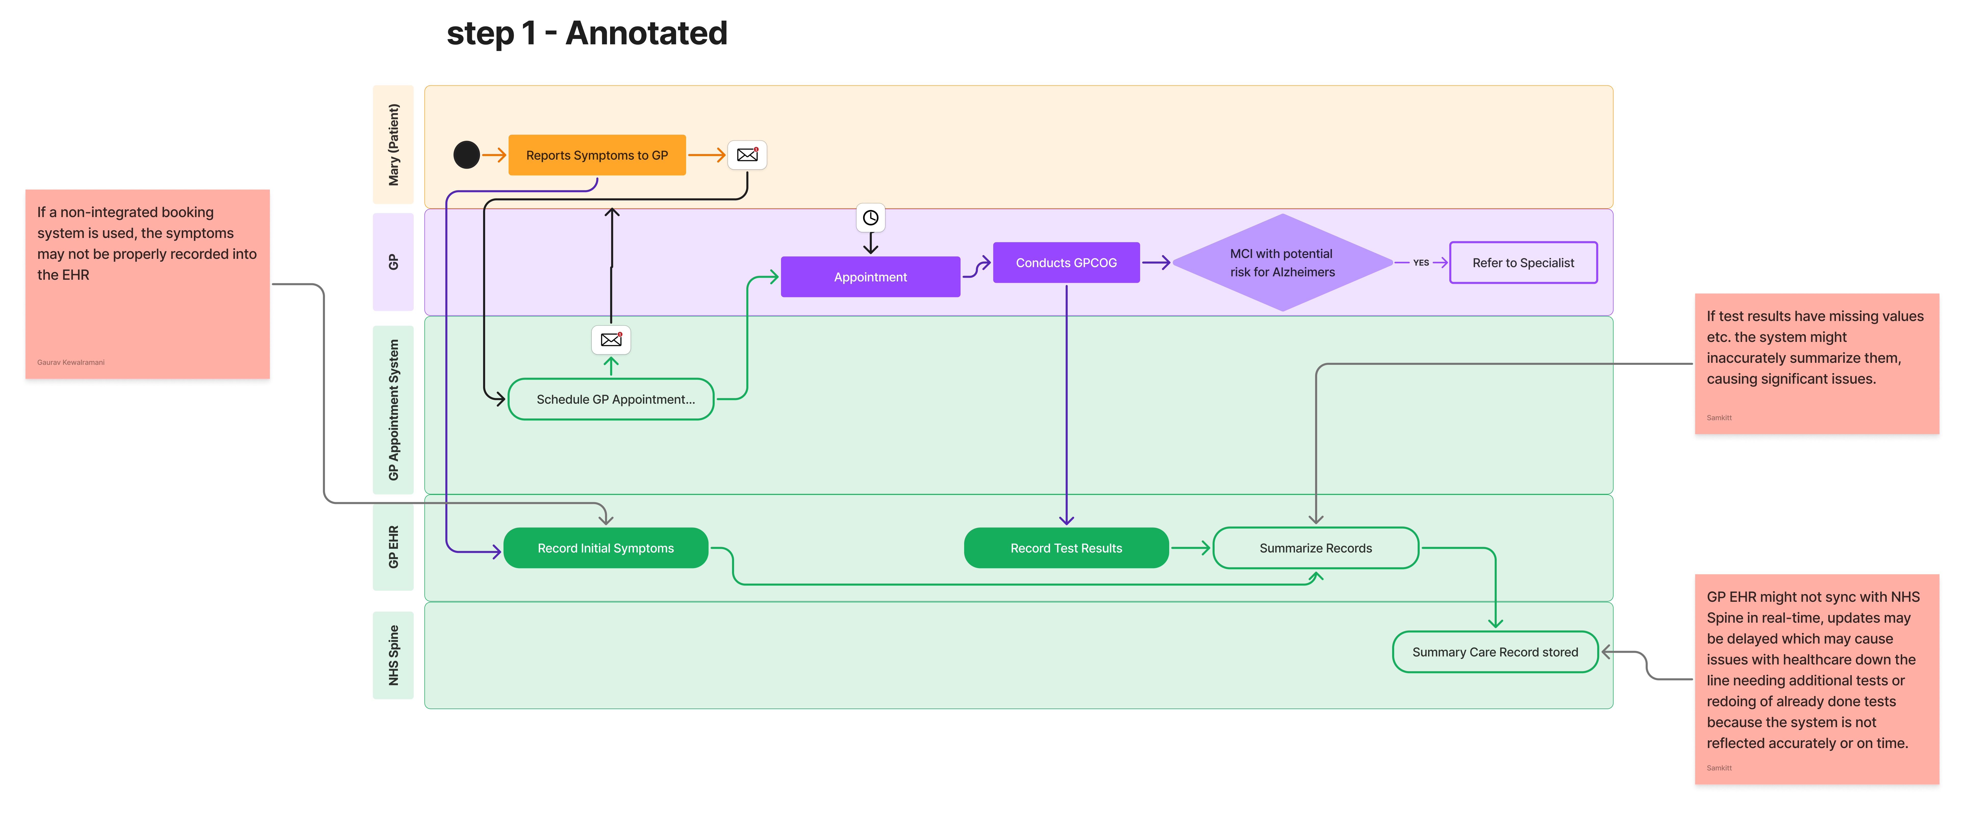
Swimlane (Step 1)
Notes:
[Samkitt Patni]: The first step in Mary's healthcare journey is her initial contact with her GP. Mary contacts her GP to report her symptoms. These are recorded and she is asked to book an appointment with the GP. This is done through the appointment system (which may be via phone or via a website). On the day of the appointment, a brief cognitive test called the GCPOG or 6CIT is conducted which assesses if her memory loss symptoms are caused by reversible causes like depression or medication side effects. However, if this is not the case and a risk of Alzheimer's is detected, then the GP refers her to a specialist memory service for further assessment. Throughout the process, the results are recorded in the GP HER and synced with NHS Spine. There are many challenges and issues that might occur throughout this step. If the booking system used by the GP is not integrated, the symptoms reported may not be properly recorded. Often test results for such tests aren't deterministic answers. This may prove to be tough to record into any particular format which may cause the summarizer to inaccurately summarize them which may cause inaccuracies in recording of results and cause errors for the patient. A major issue is with intersystem communication. The GP EHR might not sync with the NHS Spine in real time. This can cause major inconveniences for the patient and the proper integration of these systems is of high importance.

Slide 7
Swimlane (Step 2)
Notes:
[Gaurav Kewalramani]: After step 1 (i.e., when Marry goes to GP), she is referred to a specialist, which then leads to an appointment scheduled through the clinic's appointment system. Marry then undergoes a blood test, followed by an ACE-III test and an MRI to assess cognitive function. If a risk for Alzheimer’s is identified, a genetic test is conducted. Throughout the process, test results are recorded in the Memory Clinic's EHR and synchronized with the NHS Spine for diagnosis and assessment. The final step involves developing a care plan and referring the patient back to their GP. Several potential challenges are highlighted, such as delays due to paper-based forms, manual data entry errors, issues with system integration across different healthcare platforms, and reporting delays from radiology departments, especially if imaging is conducted offsite. These inefficiencies could impact patient care and workflow efficiency, emphasizing the need for better digital integration and streamlined communication between systems.

Slide 8
Swimlane (Step 3)
Notes:
[Suha Shafi] Looking at step 3 of our care pathway – this is where the real teamwork happens after Mary gets her diagnosis.
So Mary starts here at the top, receiving her diagnosis and care instructions. Her GP reviews what the specialists found and updates her care plan. All of this gets synced through the NHS Spine so everyone's on the same page.
The Memory Clinic team is really the quarterback here – they develop Mary's care plan, make referrals, and coordinate with all the allied health professionals who'll be working with her – that's the OTs, dietitians, mental health specialists, and others.
But I want to point out some real-world challenges we're seeing:
First, these updates don't always make it into the central EHR in a timely way – sometimes they get delayed or missed entirely.
Each allied health provider tends to keep their own records, which don't always talk nicely with our Memory Clinic systems. This creates blind spots in Mary's overall care picture.
Our pharmacy connections are another concern – they often don't have the full clinical context they need. Local pharmacies are mainly connected to GP systems, not specialist services.
And finally, the biggest challenge – there are so many moving parts in this interdisciplinary communication. If these systems aren't seamlessly integrated, we risk delays and lost data.

Slide 9
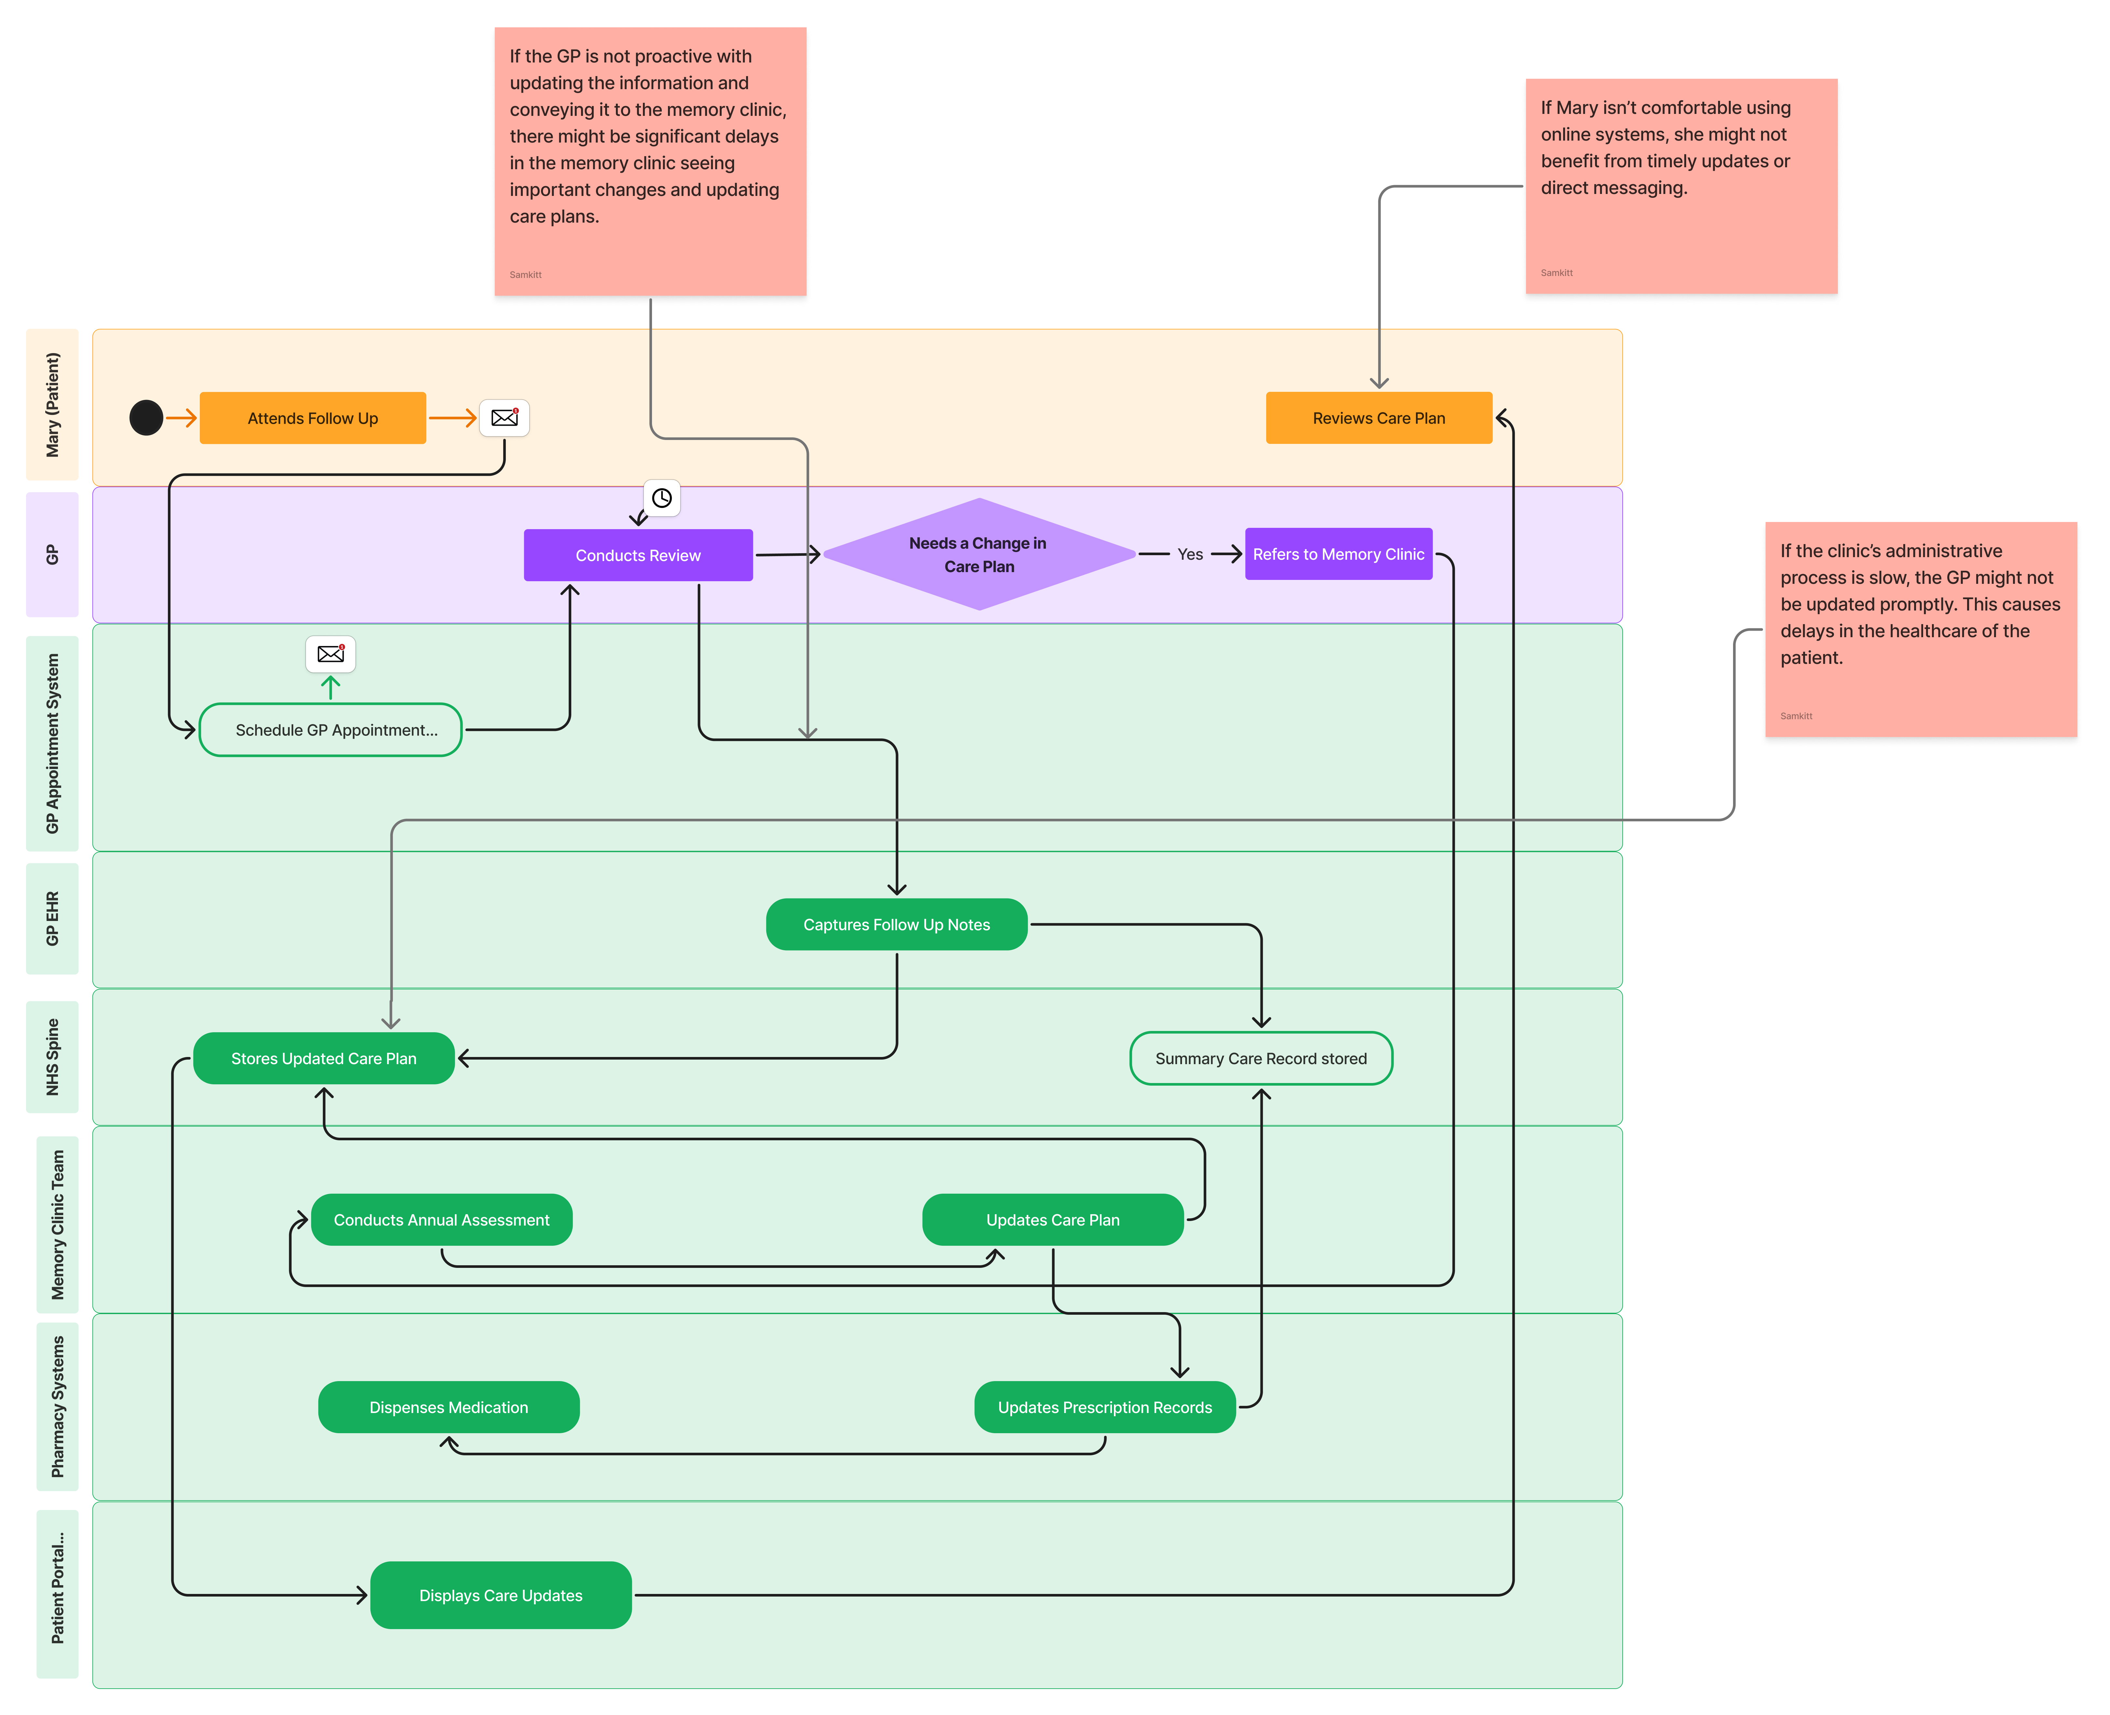
Swimlane (Step 4)
Notes:
[Sunjeev S] : After receiving her diagnosis, Marry gets care instructions and the GP reviews specialist findings. The GP then updates her care plan and syncs these updates with the broader system. The care team develops the care plan further and may refer Marry to allied health professionals. These professionals assess Marry and contribute notes, which are then integrated into her care plan. Team messages are coordinated, specialist reports are shared, and any medication requirements are passed along to pharmacies. The pharmacy dispenses medication and may send alerts, while the patient portal displays diagnoses and appointments. Key issues in this stage include poor integration of EHRs across services, delays in syncing data, and communication breakdowns among interdisciplinary teams. Pharmacies may also lack access to full clinical histories, and allied health services may not feed data back into the central system, all of which can lead to fragmented care and data mismatches.

Slide 10
Data-flows between Actors
Will make a diagram for this slide later
Data Type | Source | Destination(s)
Symptoms Data | Patient/GP | GP EHR → NHS Spine
Appointment Info | GP/Clinic Systems | GP/Clinic EHRs
Test Requests (Blood/MRI) | GP/Clinic | Lab / Radiology Systems
Test Results | Labs / Imaging | Clinic EHRs → GP EHR → NHS Spine
Cognitive Assessments | GP/Clinic | EHRs → NHS Spine
Diagnosis & Risk Flags | Clinic | GP EHR → NHS Spine
Care Plans | GP / Memory Clinic | Primary Care Team → NHS Spine → Allied Health / Pharmacy
Allied Health Notes | Allied Healthcare Systems | GP / Memory Clinic (manually or via integration)
Medication Updates | GP / Memory Clinic | Pharmacy Systems → Patient Portal
Follow-Up Notes | GP | NHS Spine → Memory Clinic / Care Team
Symptoms & Test Orders:
Mary → GP → Primary Care EHR → LIS (blood test results return to EHR).
Referral Data:
Primary Care EHR → Digital Referral System → Memory Clinic EHR (via NHS Spine).
Assessment & Imaging:
Memory Clinic → Hospital EHR → RIS/PACS (MRI results return to EHR).
Care Plan Updates:
Memory Clinic → Integrated Care Coordination Platform → Allied Health Systems.
Patient Access:
Hospital EHR → Patient Portal (displays diagnosis, appointments for Mary).
Data Syncing:
Primary Care EHR & Hospital EHR → NHS Spine (syncs records across systems).
Notes:
[Sunjeev Somu Arunachalam & Suha Shafi]: This slide shows how data flows between actors in Mary’s care journey. First, when Mary reports symptoms to her GP, this data goes into the Primary Care EHR and is sent to the LIS for blood tests, with results flowing back to the EHR. When the GP refers Mary to the Memory Clinic, referral data moves from the Primary Care EHR through the Digital Referral System to the Memory Clinic EHR, synced via the NHS Spine. During the Memory Clinic assessment, test orders and MRI results flow between the Hospital EHR and RIS/PACS. The Memory Clinic shares care plan updates via the Integrated Care Coordination Platform to Allied Health Systems. Mary accesses her diagnosis and appointments through the Patient Portal, which gets data from the Hospital EHR. Finally, the NHS Spine syncs records from both EHRs to ensure continuity across the system. These flows keep Mary’s care coordinated and accessible.

Slide 11
What We Noticed in Mary’s Journey
Strong Coordination: Multiple actors (GP, Memory Clinic, Allied Health) work together seamlessly via systems like the Integrated Care Coordination Platform.
Critical Role of NHS Spine: Syncs data (e.g., Summary Care Record, care updates) across systems, ensuring continuity of care.
Patient Empowerment: The Patient Portal allows Mary to access her records and appointments, keeping her engaged in her care.
Time Variability: Steps vary widely in duration (e.g., 1–7 days for GP visit vs. 4–8 weeks for Memory Clinic), highlighting potential delays.
Data Flow Complexity: Multiple systems (e.g., EHRs, RIS/PACS, LIS) exchange data, requiring robust integration to avoid errors.
Allied Health Impact: Support from Occupational Therapy, Dietitian, and Speech Therapist significantly enhances Mary’s quality of life.“
Symptom Impact: Mary’s memory lapses and disorientation affect her ability to engage with care (e.g., following appointment schedules).
Notes:
[Mohammad Wathiq Soualhi]: Here’s what we noticed while mapping Mary’s journey. First, there’s strong coordination between actors like the GP, Memory Clinic, and Allied Health professionals, made possible by systems like the Integrated Care Coordination Platform, which shares care plans efficiently. Second, the NHS Spine plays a critical role, syncing data like the Summary Care Record across systems to ensure continuity, as without it, care could be fragmented. Third, the Patient Portal empowers Mary by giving her access to her diagnosis and appointments, keeping her engaged. We also noticed variability in timing. While the initial GP visit takes just 1 to 7 days, the Memory Clinic assessment can take 4 to 8 weeks, which might indicate potential delays. Another observation is the complexity of data flows, multiple systems like EHRs, RIS/PACS, and LIS exchange data, requiring robust integration to avoid errors. Additionally, we observed that Mary’s symptoms, like memory lapses and disorientation, affect her ability to engage with care, for example, she might struggle to follow appointment schedules. Finally, the support from Allied Health professionals, like Occupational Therapy, a Dietitian, and a Speech Therapist, significantly enhances Mary’s quality of life by addressing her practical and emotional needs. These insights helped us understand both the strengths and challenges in Mary’s care.

Slide 12
Challenges in Mary’s Care Journey
Assessment Delays: Memory Clinic assessment takes 4–8 weeks, potentially delaying diagnosis and care.
Data Integration Risks: Multiple systems (EHRs, RIS/PACS, LIS) increase the risk of errors or data mismatches."
Limited Family Support: Family/Caregivers are involved but lack formal guidance or resources to support Mary.
Lifestyle Barriers: Mary’s high-sugar/sodium diet may worsen her condition and exacerbate cognitive decline (Lancet Neurology, 2021), but dietary support is delayed until Step 3.
Lack of Early Psychological Support: Mary’s anxiety is noted, but mental health support (CMHT) isn’t accessed until Step 3.
Genetic Testing Access: Mary’s family history warrants APOE ε4 testing, but access is conditional and not routine.
Forgetting Appointments: Mary’s memory lapses may cause her to forget appointments (e.g., email of appointment in Step 1), risking missed care.
Notes:
[Suha Shafi]: Here are the challenges we identified in Mary’s journey. First, there are assessment delays—the Memory Clinic assessment takes 4 to 8 weeks, which could delay her diagnosis and care, especially since early intervention is critical for MCI. Second, the complexity of data integration across systems like EHRs, RIS/PACS, and LIS increases the risk of errors or data mismatches, potentially affecting care coordination. Third, while Mary’s family and caregivers are involved, they lack formal guidance or resources to support her, which might add to her anxiety. Fourth, Mary’s high-sugar and sodium diet may worsen her condition, but dietary support from a Dietitian doesn’t start until Step 3, missing an early opportunity. Fifth, there’s a lack of early psychological support, Mary’s anxiety is noted in her symptoms, but mental health support from the Community Mental Health Team isn’t accessed until Step 3, which could leave her struggling emotionally. Furthermore, given Mary’s strong family history of Alzheimer’s, genetic testing like APOE ε4 could provide valuable insights, but access is conditional and not routine, potentially missing a chance for personalized care. Finally, Mary’s memory lapses, a key symptom of her MCI, may cause her to forget appointments for example, in Step 1, she receives an email for her GP follow-up but might forget to attend, risking missed care. These challenges highlight areas where the system could improve to better support patients like Mary. These challenges highlight areas where the system could improve to better support patients like Mary.

Slide 13
Solution Ideas to Improve Mary’s Care
Faster Assessments: Prioritize Memory Clinic referrals for high-risk patients (e.g., family history) to reduce wait times.
Enhanced Data Integration: Implement AI-driven tools to cross-check data across systems (EHRs, RIS/PACS) for accuracy.
Family Support Program: Provide NHS-led workshops or resources for caregivers to better support patients like Mary.
Early Lifestyle Intervention: Introduce dietary counseling in Step 1 (GP visit) to address Mary’s high-sugar/sodium diet sooner.
Early Mental Health Support: Offer initial counseling or CMHT screening during Step 1 to manage Mary’s anxiety, since anxiety management in early stages improves patient engagement (American Psychiatric Association [APA], 2022).
Routine Genetic Testing: Expand access to APOE ε4 testing for patients with family history to enable personalized care plans.
Appointment Reminders: Send automated SMS reminders alongside emails to help Mary remember appointments.
Notes:
[Gaurav Kewalramani] Here are some solution ideas to address the challenges in Mary’s care. To tackle assessment delays, we suggest prioritizing Memory Clinic referrals for high-risk patients like Mary, who has a family history of Alzheimer’s, to reduce wait times. For data integration risks, implementing AI-driven tools to cross-check data across systems like EHRs and RIS/PACS could improve accuracy. To support Mary’s family, an NHS-led program with workshops or resources for caregivers could help them better assist her. For her high-sugar and sodium diet, introducing dietary counseling right at the GP visit in Step 1 could address this risk factor earlier. To manage Mary’s anxiety, offering initial counseling or a CMHT screening during Step 1 would provide early mental health support. Finally, expanding routine access to APOE ε4 genetic testing for patients with a family history could enable more personalized care plans for Mary. Finally, to prevent Mary from forgetting appointments (like the email in Step 1) we suggest sending automated SMS reminders alongside emails to ensure she attends. These ideas aim to improve Mary’s care experience and outcomes. These ideas aim to improve both the system and Mary’s experience as she navigates her MCI care.

Slide 14
References
Alzheimer’s Association. (2024). 2024 Alzheimer’s disease facts and figures. Retrieved from https://www.alz.org/alzheimers-dementia/facts-figures
Alzheimer’s.gov. (2024). Mild cognitive impairment. Retrieved March 18, 2025, from https://www.alzheimers.gov/alzheimers-dementias/mild-cognitive-impairment
American Psychiatric Association (APA). (2022). The American Psychiatric Association Practice Guideline on Dementia. DOI: 10.1176/appi.books.9780890426787
Lancet Neurology. (2021). Treatment and Prevention of Alzheimer’s Disease. 20(6), 484-496. DOI: 10.1016/S1474-4422(21)00035-1
National Institute for Health and Care Excellence (NICE). (2018). Dementia: assessment, management and support for people living with dementia and their carers (NG97). Retrieved from https://www.nice.org.uk/guidance/ng97
National Institute on Aging (NIA). (2023). Alzheimer’s Disease Fact Sheet. Retrieved from https://www.nia.nih.gov/health/alzheimers-and-dementia/alzheimers-disease-fact-sheet
World Health Organization (WHO). (2023). Dementia. Retrieved from https://www.who.int/news-room/fact-sheets/detail/dementia
National Health Service (NHS). (2024). Alzheimer’s disease. Retrieved March 25, 2025, from https://www.nhs.uk/conditions/alzheimers-disease

